Slide 1
EANGUS
1 Massachusetts Avenue NW
Suite 880
Washington DC 20001
800-234-EANG (3264)

Slide 2
Who We Are
An Association of Associations
54 State Chapters and 1 National Chapter
7 geographical areas
Almost 40,000 members—should be 400,000
History dating back to 1970 (SD and MS)
Washington DC presence since 1989
THE professional association for National Guard enlisted men and women, their families, retirees

Slide 3
Who We Are

Slide 4
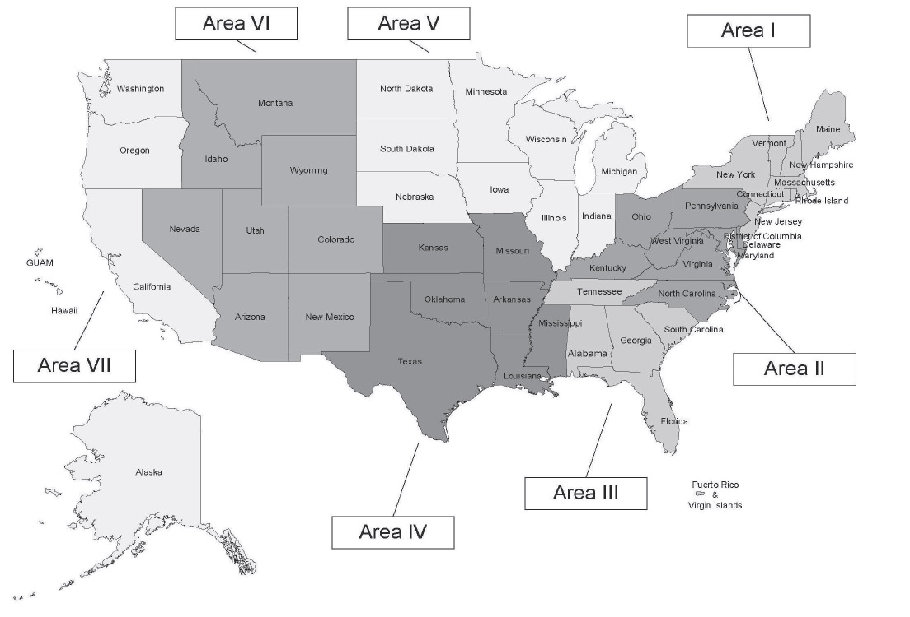
Geographic Areas

Slide 5
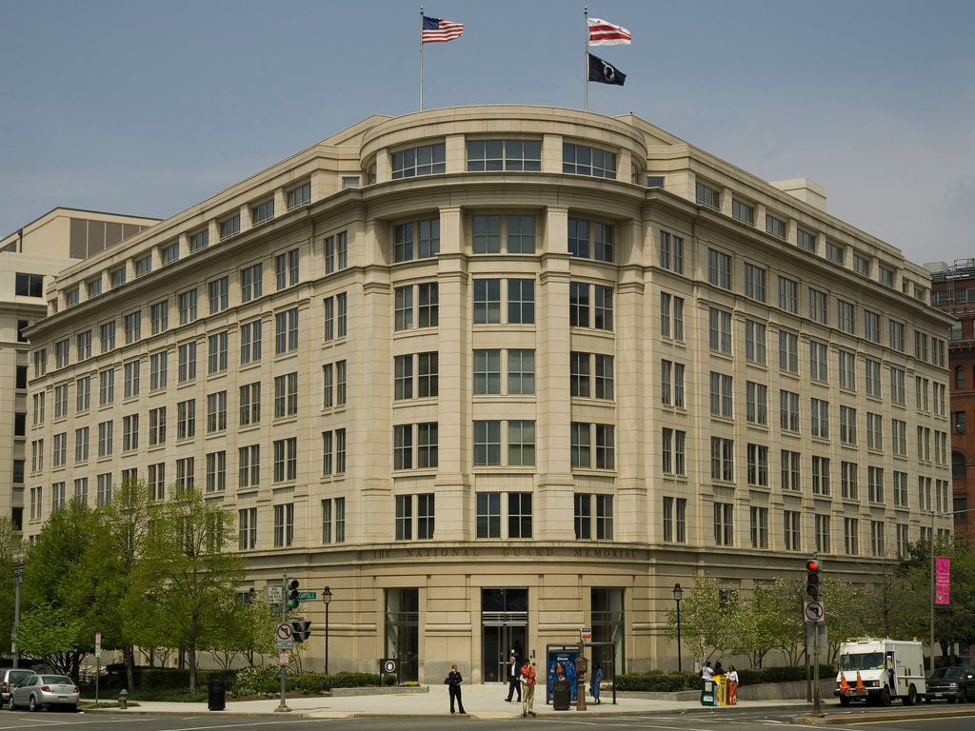
New Office
Sold Alexandria property Dec 2016
National Guard Memorial Building 8th (top) floor
Close to Union Station, Senate, Capitol, Metro
Close to NGAUS, ROA, VFW
NGYF co-located

Slide 6
Major Events
May 8-11 Conference Site Visit (Reno)
May 20 Area V Caucus (Omaha)
August 27-30 Annual Conference (Reno 2017)

Slide 7
Legislative Alliances
The Military Coalition—32 VSO-MSO like EANGUS united in purpose (don’t agree on all topics)—represent 6 million members
Reserve Component Alliance—EANGUS, NGAUS, ROA, AUSA, AFA, VFW united to push reserve specific legislation
Weekly conference calls with EANGUS, NGAUS, AGAUS, National Governors Association to synch agendas and messaging

Slide 8
Hot Topics
Blended Retirement, esp. IRS limits
TRICARE Reform in 2017/2018; still pushing for TRS for federal employees
12304b benefits
Conversion of T32 Mil Techs to T5 in October
Mileage reimbursement for drills (100 vs. 50)
Military Student Identifier for NG school children
G-RAP investigations

Slide 9
2016 Accomplishments
Use of urgent care clinics without referrals from a doctor instead of using emergency rooms
SBP Parity for IDT deaths—Guard surviving spouses paid the same as active duty now
Veteran Status for Guard and reservists! But it conveyed no benefits

Slide 10
For more information about membership
Visit our webpage at www.ndngea.org
Email us at ndngea@gmail.com
Contact Chuck Votava at 218-779-1415
Join our Facebook Group NDNGEA

Slide 11
YOUR professional association!

