Slide 1


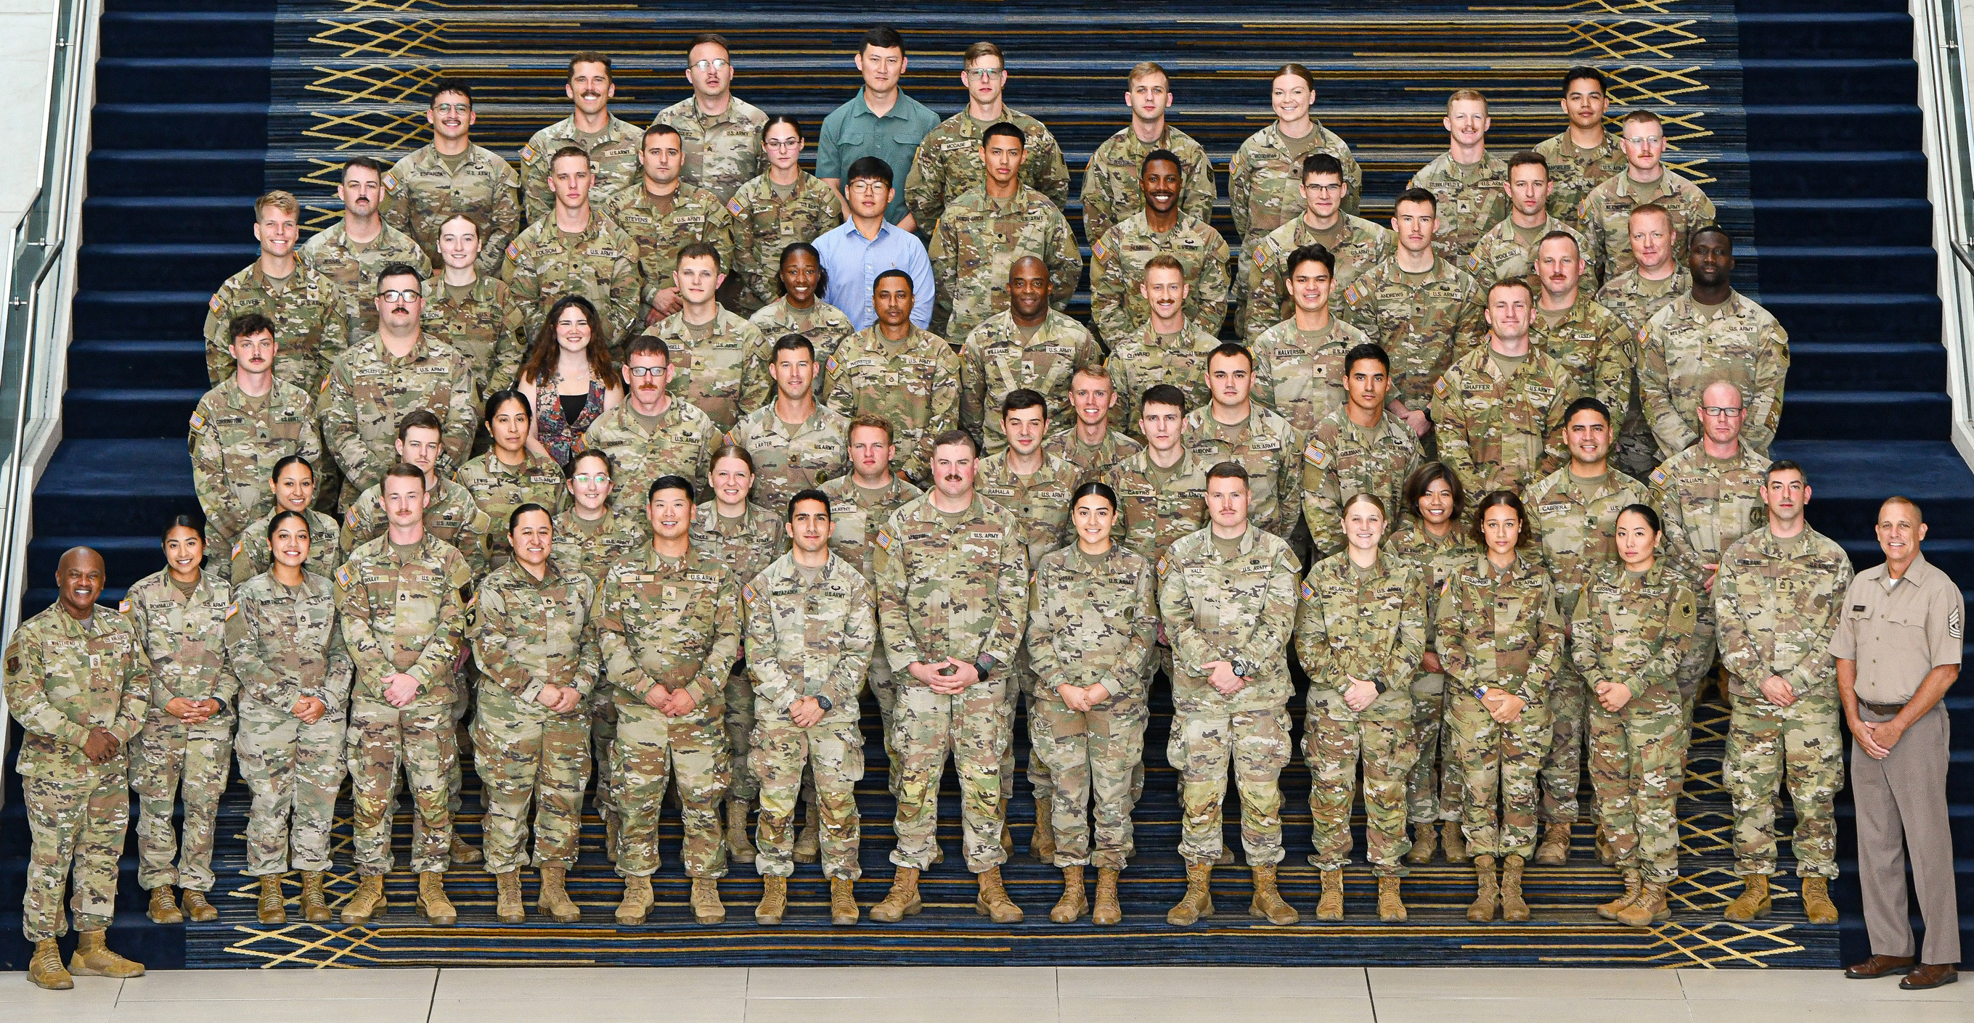
NDNGEA/EANGUS
Your professional Association

Slide 2
Who We Are
An Association of Associations
54 State Chapters and 1 National Chapter
History dating back to 1970 (SD and MS)
  NDNGEA est. in 1977
Washington DC presence since 1989
THE professional association for National Guard enlisted men and women, their families, and retirees

Slide 3
Legislative Alliances
The Military Coalition—32 VSO-MSO like EANGUS united in purpose (don’t agree on all topics)—represent 6 million members
Reserve Component Alliance—EANGUS, NGAUS, ROA, AUSA, AFA, VFW united to push reserve specific legislation
Weekly conference calls with EANGUS, NGAUS, AGAUS, National Governors Association to synch agendas and messaging

Slide 4

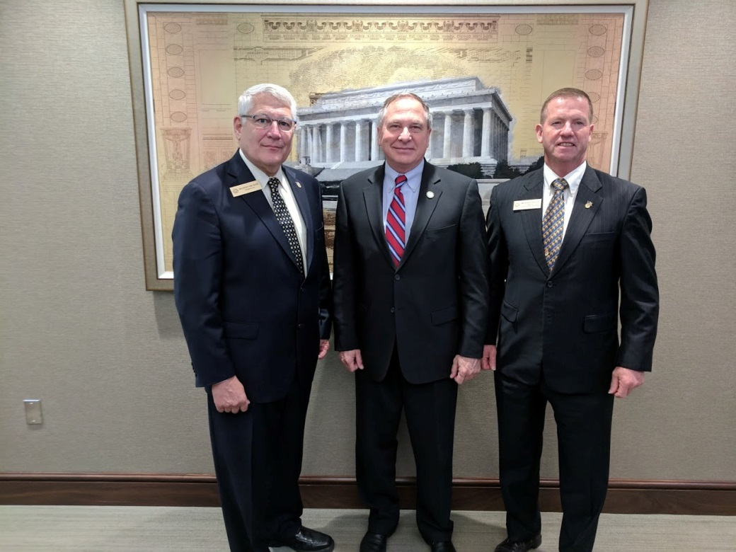
AUSA Partnership
EANGUS members have complimentary membership—all benefits; reciprocal to AUSA
AUSA helping EANGUS fill the expo floor at Annual Conference
Does not mean we buy into AUSA legislative agenda or merging associations
Capitalize on chapter synergy within State
AUSA membership alone is $20/yr or $400/Lifetime

Slide 5
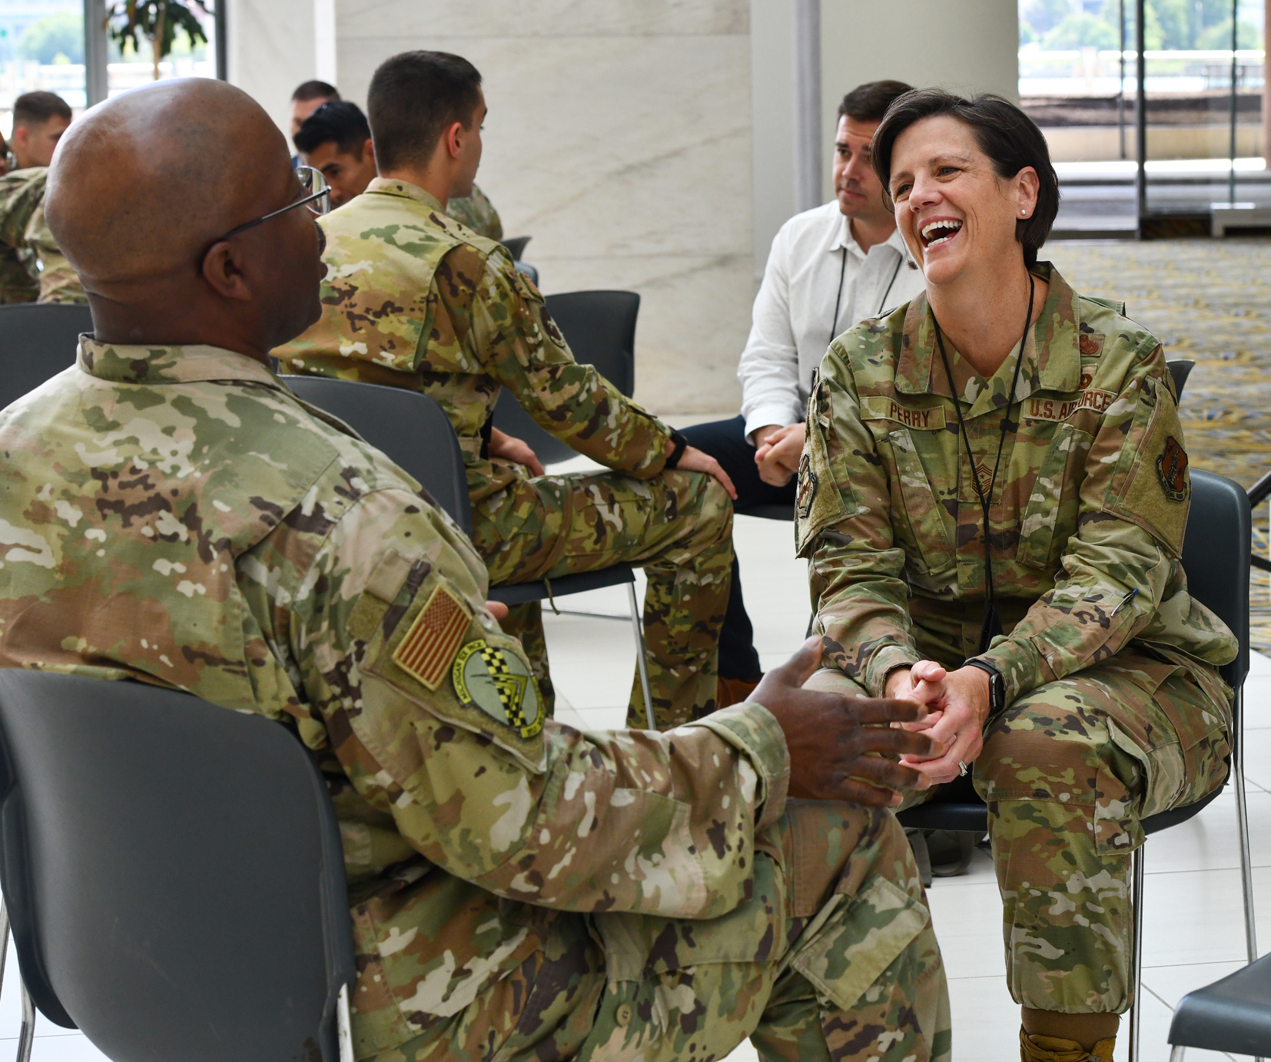
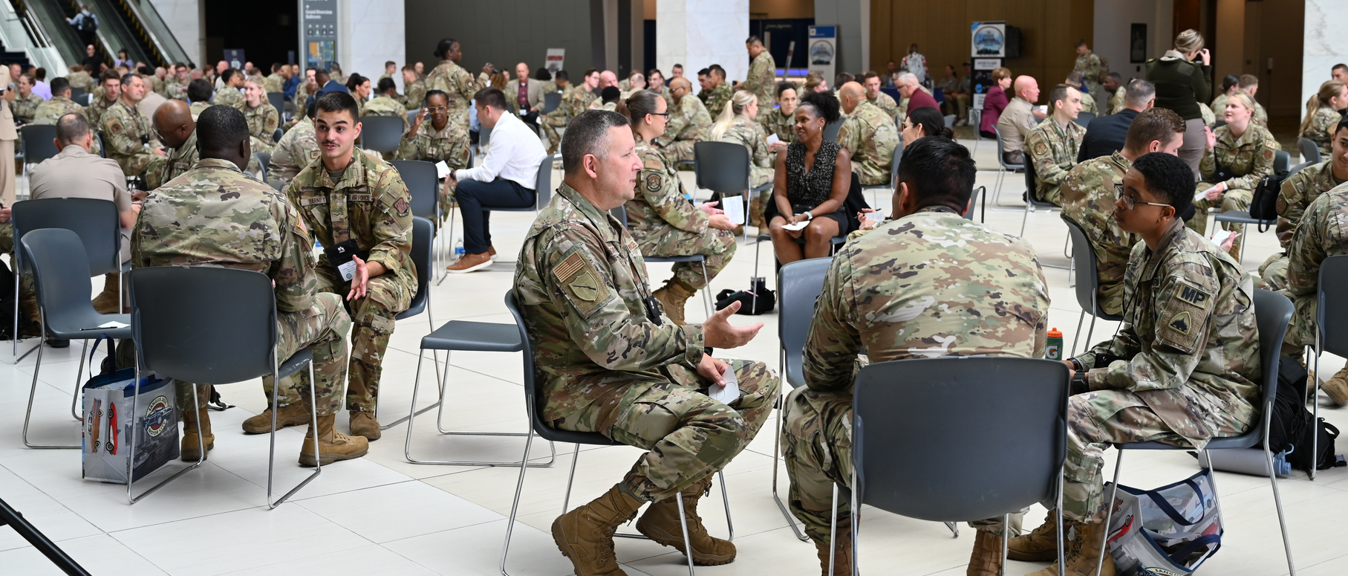
PROFESSIONAL DEVELOPMENT
As the premier professional organization for the National Guard, EANGUS provides career support and development at all levels, regardless of rank.
Notes:
First, it is probably worth saying out loud, but EANGUS is the professional organization for the National Guard. Soldiers, Airmen, Family Members, and Partners at all levels, regardless of rank, join our organization because we are able to support their career, their development, and bring about change for the future of the National Guard. Even though the professional development program that we generically apply to our Junior ranks, the truth is, we provide professional development to everyone.
Second, before I talk about the Junior Ranks programs, it is also important to mention how our version of development is unique and different. In the military, we have very structured schools to develop leaders. We teach them what it means to be a military leader via a set curriculum that is paired with the next level of expectations for their rank and position. If you take this class at Fort Moore, GA or Camp Ball, LA….. the classes are built very much the same, almost identical. You get the same “standard” of leadership lesson to develop a person to reach potential. EANGUS, on the other hand, we provide lessons that are not cookie cutter, inside a book, or part of a lesson plan. We have the chance to bring real experts with a variety of leadership perspectives, and with real world experience, to all of our members. We give them professional development that is outside the box and has uniqueness in its tone.
So where we really excel in our professional development is by providing these opportunities for personal and professional growth to Junior Ranked members of the National Guard from all across the country. The highlight of these opportunities is really on display at our annual conference, where we even get support from the National Guard Bureau by paying members to attend the event. There we bring in multiple speakers, classes, educational events, and networking sessions to hopefully give the future leaders tools that will help them to return home and make a difference. This is also paired with a chance for those junior leaders to interact and ask questions of the highest-ranking members of the Department of Defense, Industry partners, and the National Guard. I have attached the agenda that we gave to those members this last year, hopefully that will help share some light on the week of interactions that they had.
And while the conference is are most notable professional development session that takes place, it is all of the other opportunities that happen throughout the year that also show some significance to EANGUS. When we bring a new member, young Soldier or Airmen to DC, and let them visit the halls of congress, sit down with a congressman, and hear from key staff members on the legislative process, they are learning how to express their voice, make change for the future, and be a more impactful leader for the Nation as a whole. When we introduce them to industry partners, they learn how the Defense Ecosystem creates and develops the capabilities of our warfighters to serve our country and fight our nations wars. And when they interact with members from other states, they are interacting with the leaders that they will one day serve with when they are asked to protect our way of life.

Slide 6
National Legislative Achievements
Unlimited urgent care clinic visits without referrals
Survivor Benefits Plan (SBP) parity for IDT deaths
Veteran status for RC Retirees
12304b GI Bill eligibility with retroactivity
Pre and post mob TRICARE coverage
Additional AGR Allocations
4.5% pay increase for Servicemembers and a 14.5% pay increase for E1 through E4 (Effective April of 2025) from the FY2025 NDAA

Slide 7
North Dakota Legislative Achievements
Education scholarships and tuition waivers or reimbursements
State income tax advantages
Group life insurance
Distinctive vehicle license plates
State bonus for combat zone service
Interest free emergency loans
Burial rights in state cemeteries
Construction and maintenance of Veteran’s Care facility in Lisbon, ND
In-state hunting and fishing licenses for ND Guardsmen who live out of state
No State income tax for retired military pay

Slide 8
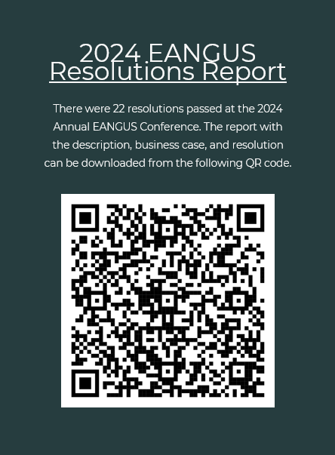
Hot Topics for future legislative issues:
Tricare Reserve Select for federal employees and dual status techs
Vehicle excise tax credit while deployed
Blended Retirement, esp. IRS limits on contributions
Military Student Identifier
Mileage reimbursement for drills
TRICARE Reform for all

Slide 9

For more information about membership
Visit our webpage at www.ndngea.org
  Annual membership rate of $29 with option to auto-renew
  Lifetime membership rate of $290
Email us at ndngea@gmail.com
Contact Chuck Votava at 218-779-1415
Join our Facebook Page

Slide 10

YOUR professional association!

Slide 11
Questions

